Slide 1
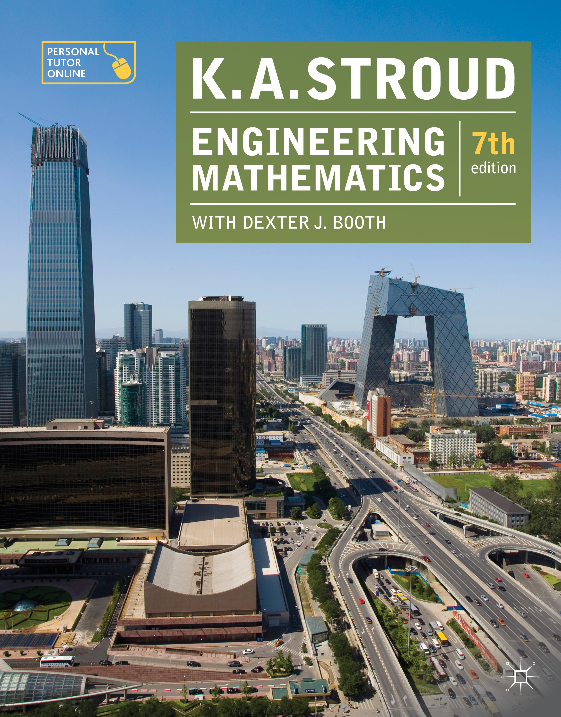
PROGRAMME 8
DIFFERENTIATION APPLICATIONS

Slide 2
Differentiation of inverse trigonometric functions
Derivatives of inverse hyperbolic functions
Maximum and minimum values
Points of inflexion

Slide 3
Differentiation of inverse trigonometric functions
Derivatives of inverse hyperbolic functions
Maximum and minimum values
Points of inflexion

Slide 4

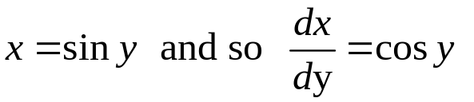
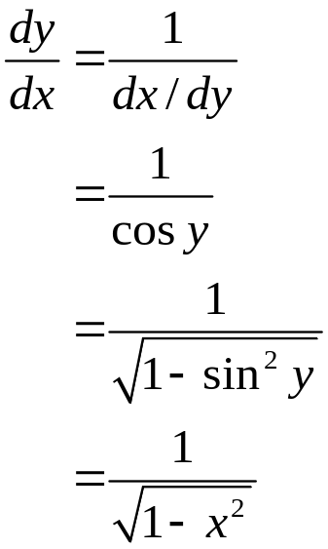
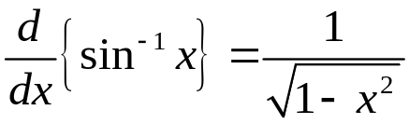
Differentiation of inverse trigonometric functions
If then
Then:

Slide 5
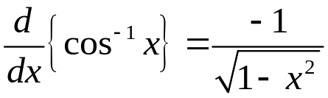
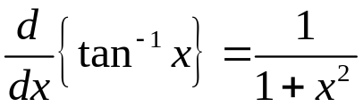
Differentiation of inverse trigonometric functions
Similarly:

Slide 6
Differentiation of inverse trigonometric functions
Derivatives of inverse hyperbolic functions
Maximum and minimum values
Points of inflexion

Slide 7
Differentiation of inverse trigonometric functions
Derivatives of inverse hyperbolic functions
Maximum and minimum values
Points of inflexion

Slide 8

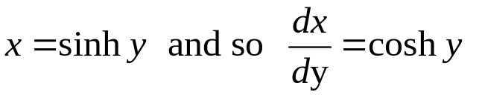
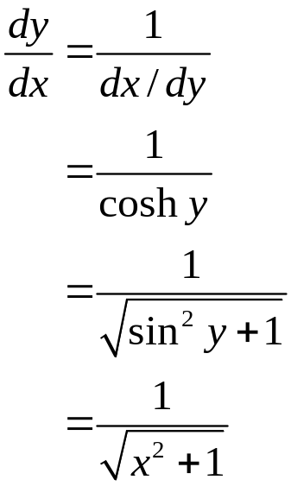
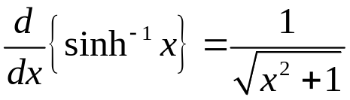
Derivatives of inverse hyperbolic functions
If then
Then:

Slide 9
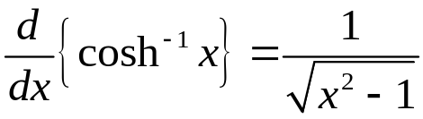
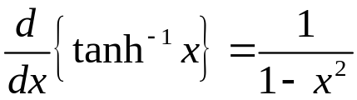
Derivatives of inverse hyperbolic functions
Similarly:

Slide 10
Differentiation of inverse trigonometric functions
Derivatives of inverse hyperbolic functions
Maximum and minimum values
Points of inflexion

Slide 11
Differentiation of inverse trigonometric functions
Derivatives of inverse hyperbolic functions
Maximum and minimum values
Points of inflexion

Slide 12
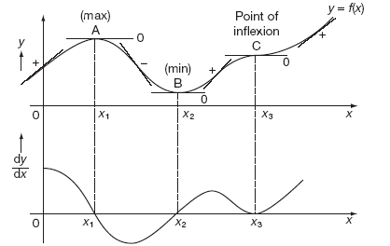
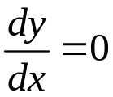
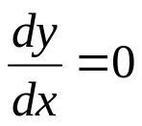

Maximum and minimum values
A stationary point is a point on the graph of a function y = f (x) where the rate of change is zero. That is where:
This can occur at a local maximum, a local minimum or a point of inflexion. Solving this equation will locate the stationary points.
local maximum/local minimum/ point of inflexion
(stationary point)

Slide 13
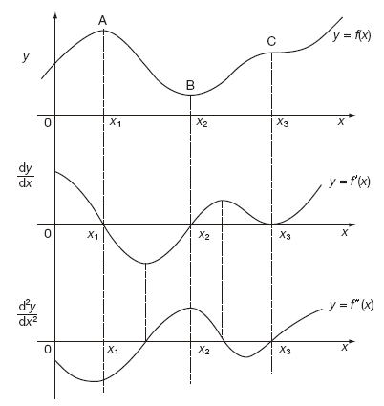
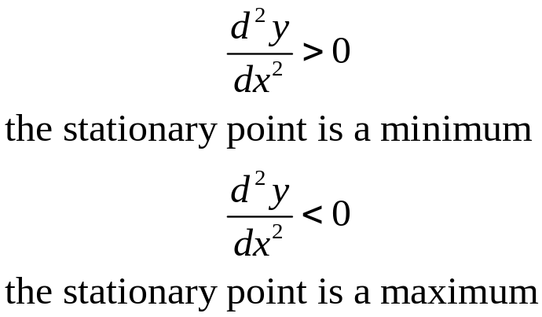
Maximum and minimum values
Having located a stationary point it is necessary to identify it. If, at the stationary point

Slide 14
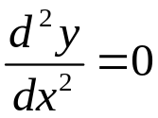
Maximum and minimum values
If, at the stationary point
The stationary point may be:
a local maximum,
a local minimum or
a point of inflexion
The test is to look at the values of y a little to the left and a little to the right of the stationary point

Slide 15
Differentiation of inverse trigonometric functions
Derivatives of inverse hyperbolic functions
Maximum and minimum values
Points of inflexion

Slide 16
Differentiation of inverse trigonometric functions
Derivatives of inverse hyperbolic functions
Maximum and minimum values
Points of inflexion

Slide 17
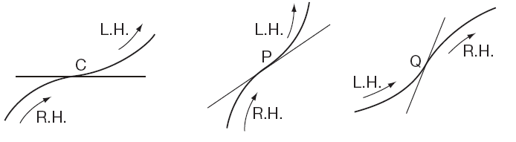
Points of inflexion
A point of inflexion can also occur at points other than stationary points. A point of inflexion is a point where the direction of bending changes – from a right-hand bend to a left-hand bend or vice versa.

Slide 18
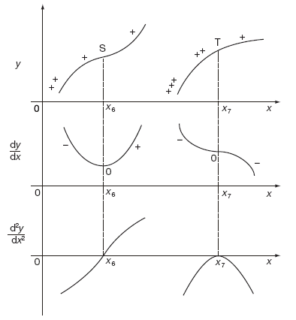
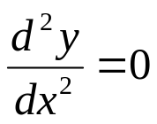
Points of inflexion
At a point of inflexion the second derivative is zero. However, the converse is not necessarily true because the second derivative can be zero at points other than points of inflexion.
Points of inflexion (P-of-I)

Slide 19
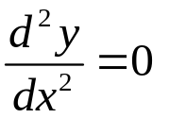
Points of inflexion
The test is the behaviour of the second derivative as we move through the point. If, at a point P on a curve:
and the sign of the second derivative changes as x increases from values to the left of P to values to the right of P, the point is a point of inflexion.

Slide 20
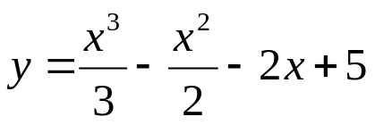
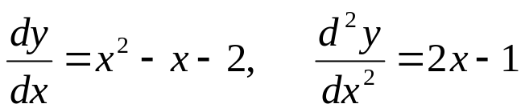
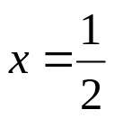

Points of inflexion
For examples, Find points of inflexion:
Solution. First derivative and second derivative are
For P-of-I,
it occurs at so
Next, test for changes of sign

Slide 21
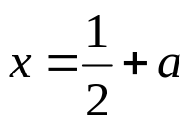
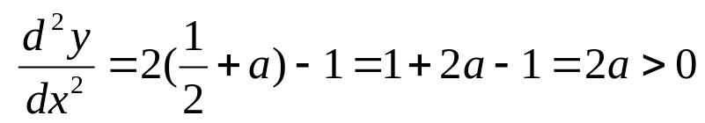
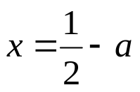
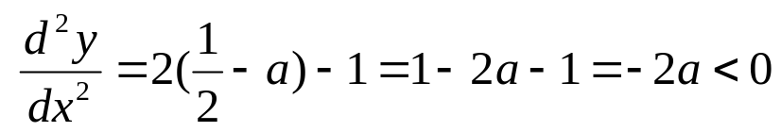
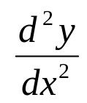

At (a>0)
At (a>0)
So, there is a change in sign of as we go through
Exercise, find points of inflexion

Slide 22
Learning outcomes
Differentiate the inverse trigonometric functions
Differentiate the inverse hyperbolic functions
Identify and locate a maximum and a minimum
Identify and locate a point of inflexion

